Slide 1
UCSD Embedded Linux Assignment 9
By
Hsuankai Chang
hsuankac@umich.edu

Slide 2
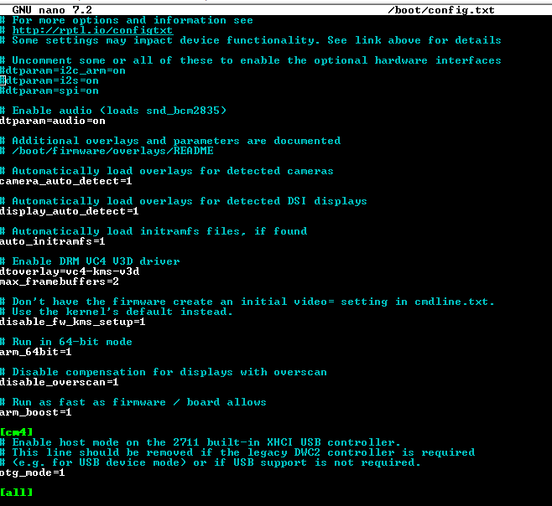
Step 1. Boot up on default, SPI is not turn on

Slide 3
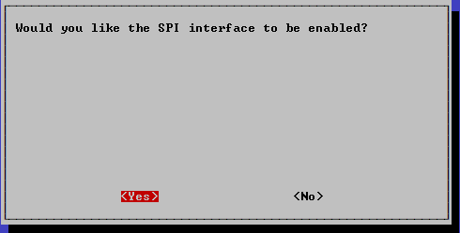
Step 2. Enable the SPI interface in raspi-config

Slide 4
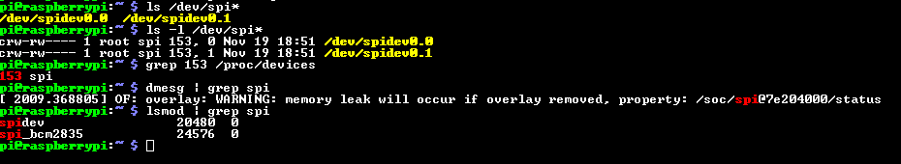
Step 3. Confirm SPI is on

Slide 5
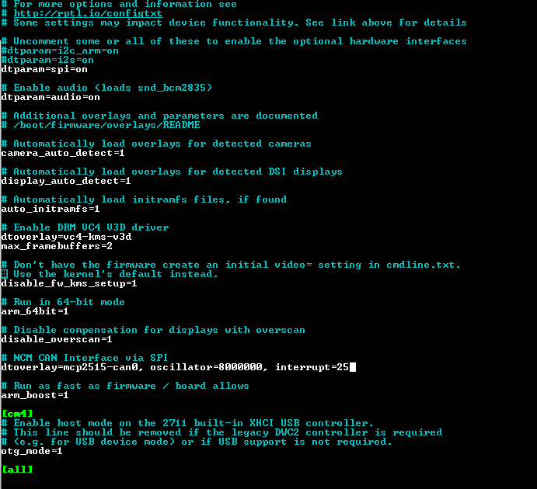
Step 4. Modify the /boot/config.txt file for mcp2515

Slide 6
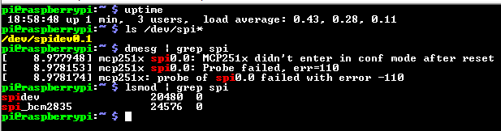
Step 5. Since I do not connect MCP2515, so the result failed when reboot

Slide 7
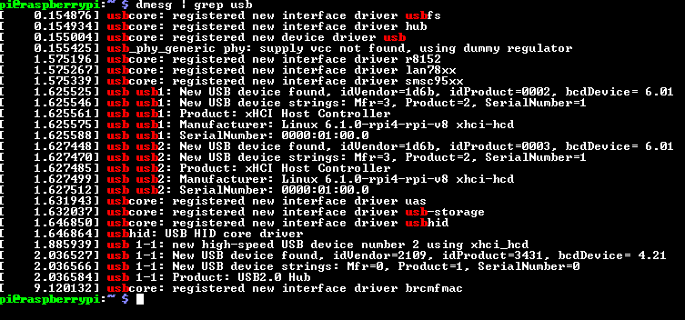
Step 6. dmesg and USB

Slide 8
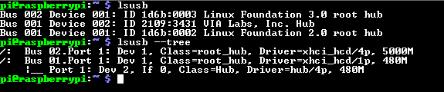
Step 7. lsusb and USB

Slide 9
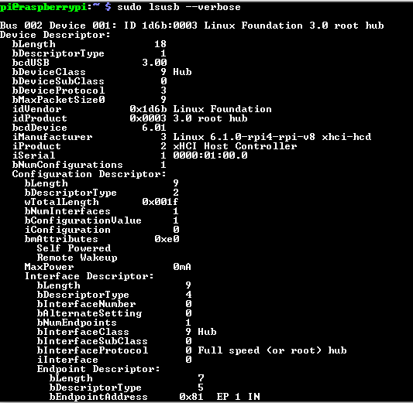
Step 8. lsusb --verbose

Slide 10
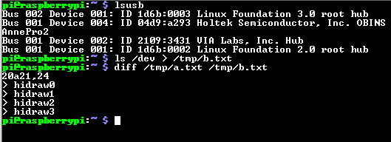
Step 9. Plug in keyboard to raspberrypi, using AnnePro2 keyboard

Slide 11
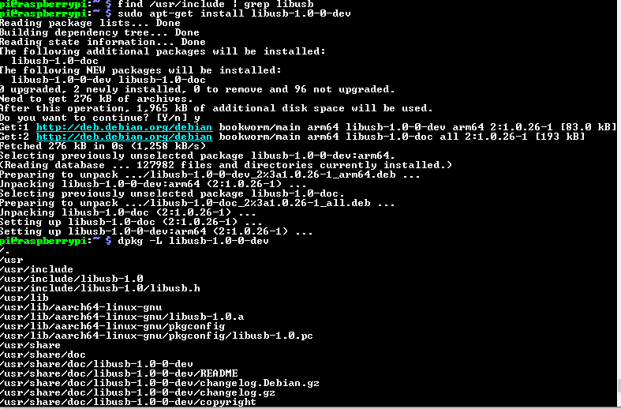
Step 10. libusb installation

Slide 12
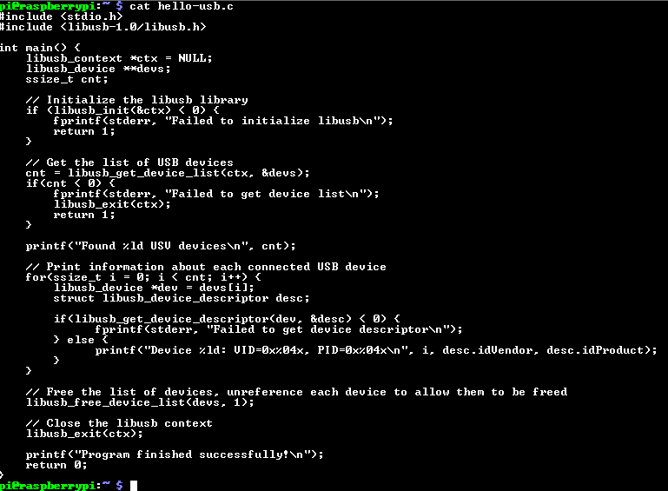
Step 11. hello-usb.c file

Slide 13
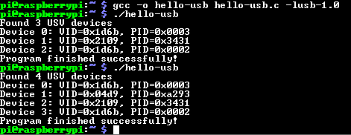
Step 12. Building and running hello-usb, before and after plugging in AnnePro2 keyboard

